Slide 1



Health Research, Inc. – Interview Presentation
COVID-19 Global Surveillance 2025
Gayathri Karthikeyan
BDS, MPH
13 August , 2025

Slide 2



Health Research, Inc. – Interview Presentation
Project Overview
Objective: Identify high-risk countries for COVID-19 in 2025 using epidemiologic metrics.
Data Source: Kaggle Open Data Repository
Approach: Data cleaning → SQL queries → Macros → Statistical analysis → Predictive modeling → Visualization.

Slide 3


Health Research, Inc. – Interview Presentation
Initial Data Cleaning (Excel)
Goal: : Prepare dataset for smooth import and processing in SAS
Key Actions:
Renamed variables – removed special characters unreadable by SAS
Corrected country names – filled in incomplete entries
Formatted numeric fields – removed commas, converted to numeric type
Handled missing values – converted all blanks and “N/A” to . (SAS missing)

Slide 4
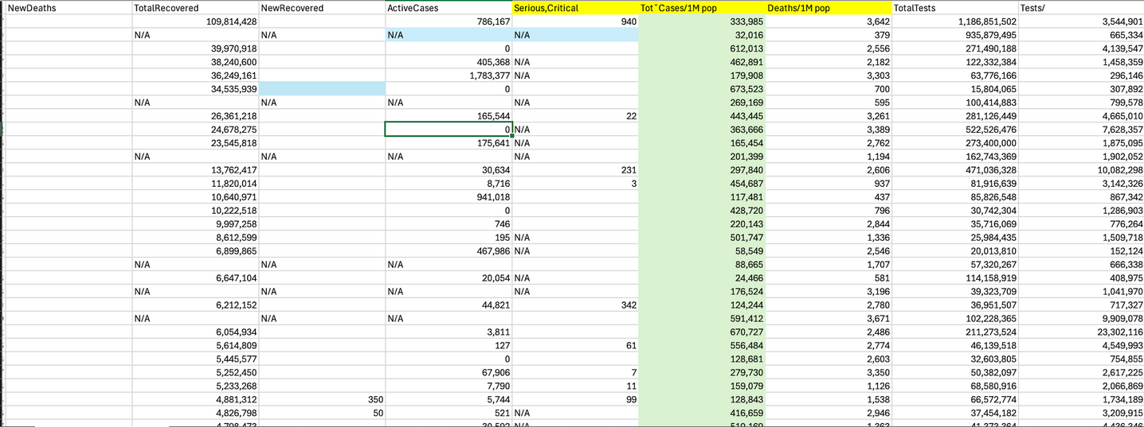
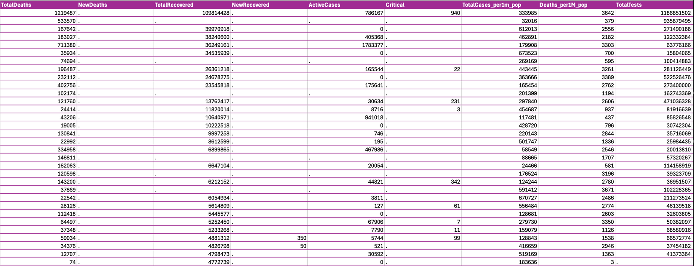
Health Research, Inc. – Interview Presentation
Before
After

Slide 5

Health Research, Inc. – Interview Presentation
Analysis-Ready Datasets
Missingness Check
Used proc means n nmiss on key variables: TotalCases, TotalDeaths, TotalRecovered, Deaths_per1M_pop, Population
Counted non-missing and missing values to identify data gaps before analysis
Feature Engineering
log_pop = log(Population + 1) → stabilizes skew, allows for zero values
Purpose-Built Subsets
project.cfr_model_data → rows with CFR_flag = 1
project.rr_model_data → rows with RR_flag = 1
project.highrisk_data → rows with HR_flag = 1

Slide 6
Health Research, Inc. – Interview Presentation
SAS SQL Queries
Goal: : Extract key descriptive statistics and rankings for COVID-19 impact assessment
Key Analyses Performed:
Continent-Level Summary
Total cases, total deaths, average deaths per 1M population
ordered by total cases (highest first)
Top/Bottom Rankings
Cases per 1M population: Top 10 countries
Deaths per 1M population: Top 10 countries
Case Fatality Rate (CFR %): Top 5 & Bottom 5
Recovery Rate (%): Top 5 & Bottom 5
Tests per 1M population: Top 5 & Bottom 5

Slide 7

Health Research, Inc. – Interview Presentation
SAS Macro
Goal: Automate repetitive COVID-19 data analysis and visualization tasks
Macros Created:
%covid_filter(var, threshold)
Filters countries where a numeric variable exceeds a user-defined threshold
Example: Countries with TotalCases > 1,000,000
%above_avg(var)
Returns countries where a variable is above the global average
Example: Above-average TotalCases
%histogram(var)
Generates a histogram and summary statistics for a numeric variable
Provides mean & standard deviation inset on the plot
%compare_vars(var1, var2)
Lists countries where one metric exceeds another
Example: TotalCases > TotalDeaths (useful for ratio checks and anomalies)

Slide 8

Health Research, Inc. – Interview Presentation
SAS Statistical Analysis
Goal: Explore COVID-19 patterns and identify predictors of high-risk countries
Descriptive & Exploratory Analysis
proc means → Summary statistics (mean, median, min, max, std) for numeric variables
proc freq → Frequency counts for categorical variables (e.g., Continent)
%histogram(var) macro → Visualize numeric variable distributions with mean & SD inset
Inferential Analysis
Spearman Rank Correlation
Compared TotalDeaths and TotalTests using Spearman’s correlation (non-parametric)
Chosen because variables were not normally distributed and may contain outliers
Purpose: To assess whether countries with higher mortality also tend to conduct more tests
Predictive Modeling
Logistic Regression
Model : HighTesting ~ CFR + log(Population)
CFR = TotalDeaths / TotalCases
Outcome variable is HighTesting (binary), not “High-Risk”
log_pop used to reduce skewness and account for large population differences

Slide 9
Health Research, Inc. – Interview Presentation
Results, Interpretations and implications
Results : Spearman’s Rank Correlation
Spearman’s rho = 0.512, p < 0.001
Indicates a moderate positive association
Interpretation: Countries with higher numbers of COVID-19 deaths also tend to have conducted a higher total number of tests.
Implications: This likely reflects reactive testing . countries facing more severe outbreaks (more deaths) scaled up testing to track and manage the situation. Ideally, you’d want testing volume to surge when cases rise.
Results: Logistic Regression
Model : High-Testing ~ CFR + log(Population)
Case Fatality Rate (CFR): Positive coefficient, p = 0.041 — countries with higher CFR had higher odds of being in the high-testing group.
log(Population): Positive coefficient, p < 0.001 — larger populations were associated with higher odds of high testing.
Model Fit:
Likelihood Ratio Chi-square = 18.24, p < 0.001
c-statistic = 0.74 → good discriminative ability.
Interpretation: Countries with both higher CFR and larger populations were more likely to be classified as high-testing
Implications: the finding suggests that testing intensity is not randomly distributed across countries , instead, it tends to be higher in places with:
Greater disease severity (higher CFR), possibly because governments and health agencies respond to perceived threat by ramping up testing to identify and contain outbreaks.
Larger populations, which may have more resources, infrastructure, or necessity to implement large-scale testing campaigns.
However, it also implies a potential equity gap, countries with lower CFR or smaller populations may test less, even if they could be underdetecting cases, meaning disease burden in those areas might be underestimated

Slide 10

Health Research, Inc. – Interview Presentation
ODS Export to Excel
Goal: Compile and organize key outputs into a structured Excel report for easy review and integration into dashboards
Export Setup
Sheets Generated:
Cases > 100k — Countries with more than 100,000 cases (ranked)
Continent Summary — Total cases, total deaths, average deaths per 1M
Top 10 Deaths per 1M — Highest mortality burden per population size
Cases vs Global Avg — Comparison and deviation from global case average
spearmens correclation — High-Risk vs Low-Risk Deaths_per1M_pop
Logistic CFR

Slide 11

Tableau Dashboard
Goal: Transform exported SAS outputs into an interactive visual summary for quick insights
High Case Burden (per 1M population):
France, Martinique, Andorra, Slovenia, and others lead the Top 10 Total Cases per 1M list
High Mortality Burden:
Peru, Bulgaria, Hungary, Bosnia & Herzegovina appear in Top 10 Total Deaths per 1M
Case Fatality Rate (CFR):
Highest CFR — Yemen, MS Zaandam, Sudan, Syria, Western Sahara
Lowest CFR — Brunei, DPRK, Iceland, South Korea, Singapore
Recovery Rates:
Highest — DPRK, Falkland Islands, South Korea, Singapore, Vatican City
Lowest — Algeria, Brunei, Egypt, Lebanon, Uganda
Testing Rates:
Highest Testing per 1M — Austria, Bermuda, Denmark, Gibraltar, UAE
Lowest Testing per 1M — Algeria, DRC, Eritrea, Niger, Syria
Continental Trends:
Europe dominates high case and high death lists
Africa and Oceania have lower proportional representation in top burden categories

Slide 12
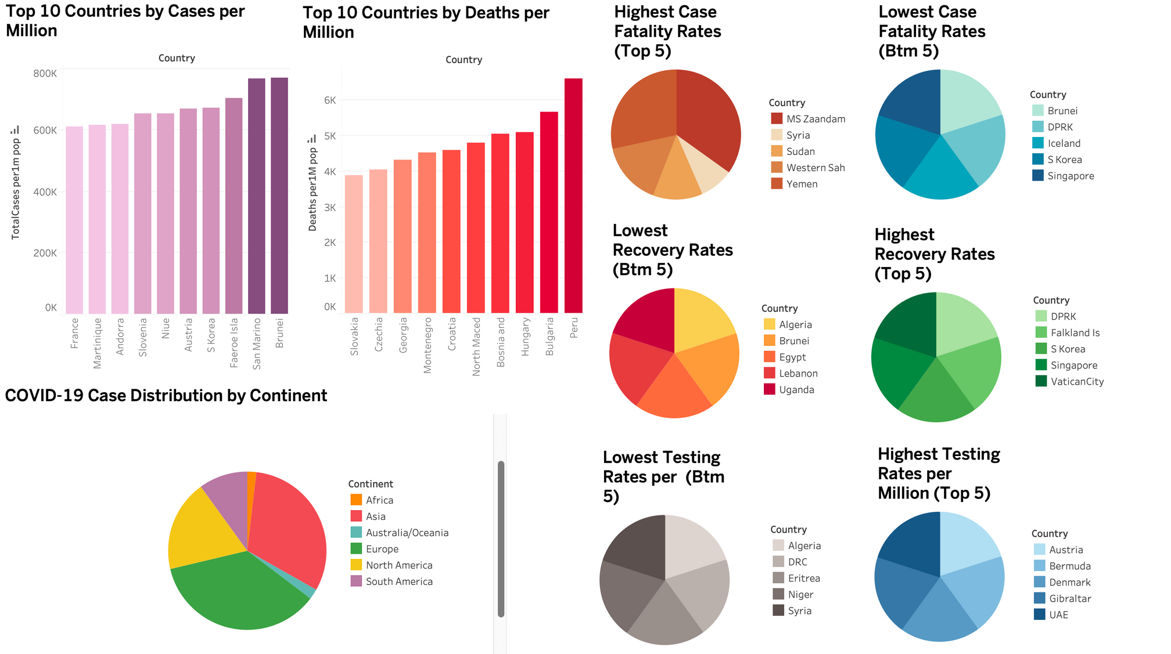
Tableau Dashboard
Health Research, Inc. – Interview Presentation

Slide 13

Health Research, Inc. – Interview Presentation
GITHUB LINK TO CODE
https://github.com/gayathri1913/COVID19_Global_Surveillance_2025

Slide 14

Health Research, Inc. – Interview Presentation
Thank You
857-999-5393
gk1998@bu.edu
Portfolio website: https://sites.google.com/bu.edu/gayathri-karthikeyan/home

